Slide 1


AXON CX AND ASU MSBA
Notes:
we are very excited to show you the work we have been working on together for the past 4 months: the text classification project for Axon customer experience

Slide 2
EXECUTIVE SUMMARY
BACKGROUND
Axon Enterprise, Inc., is a prominent provider of public safety technology solutions that prioritizes customer experience, utilizing Net Promoter Score (NPS) as a top-level metric to measure customer satisfaction and to incentivize all Axon employees to prioritize customer needs.
GOAL & OBJECTIVE
The goal of the project is to improve Axon's NPS score by better understanding customer feedback. This will be achieved by developing a machine learning model to categorize free-text responses and generating reports to identify areas for improvement. Ultimately, the objective is to assist Axon enhance the customer experience and drive business growth.
METHODOLOGY
The methodology involved creating 6 binary classification models for each of the categories using Spacy to categorize texts. Next, the models were used to classify customer feedback into the respective categories. The feedback was then analyzed to identify areas of improvement for enhancing the CX. Finally, the results were reported to stakeholders for further action.
DELIVERABLES
The deliverables include self-improving ML models that can classify customer feedback into the relevant categories, and Tableau dashboards that provide insight on areas of improvement for customer experience.
FUTURE SCOPE
Automating the categorization process by hosting the model on a server, enhancing the model to predict customer dissatisfaction, and regularly updating the model with new feedback to improve efficiency. Additionally, a web application could be developed for real-time monitoring of customer satisfaction based on primary categories.
Notes:
Executive Summary of the project & agenda of the content we will be going through today
Deliverables: The project successfully created 6 binary classification models using machine learning (ML) that were able to classify responses into the relevant categories and provide insights on areas of improvement for customer experience using a Tableau Dashboard.
Future scope: Automating the categorization of customer feedback by hosting the model on a server, enhancing the model to predict dissatisfaction from customer feedback, and regularly updating the model with new feedback for improved efficiency. Additionally, a web application could be developed for real-time monitoring of customer satisfaction based on primary categories.

Slide 3

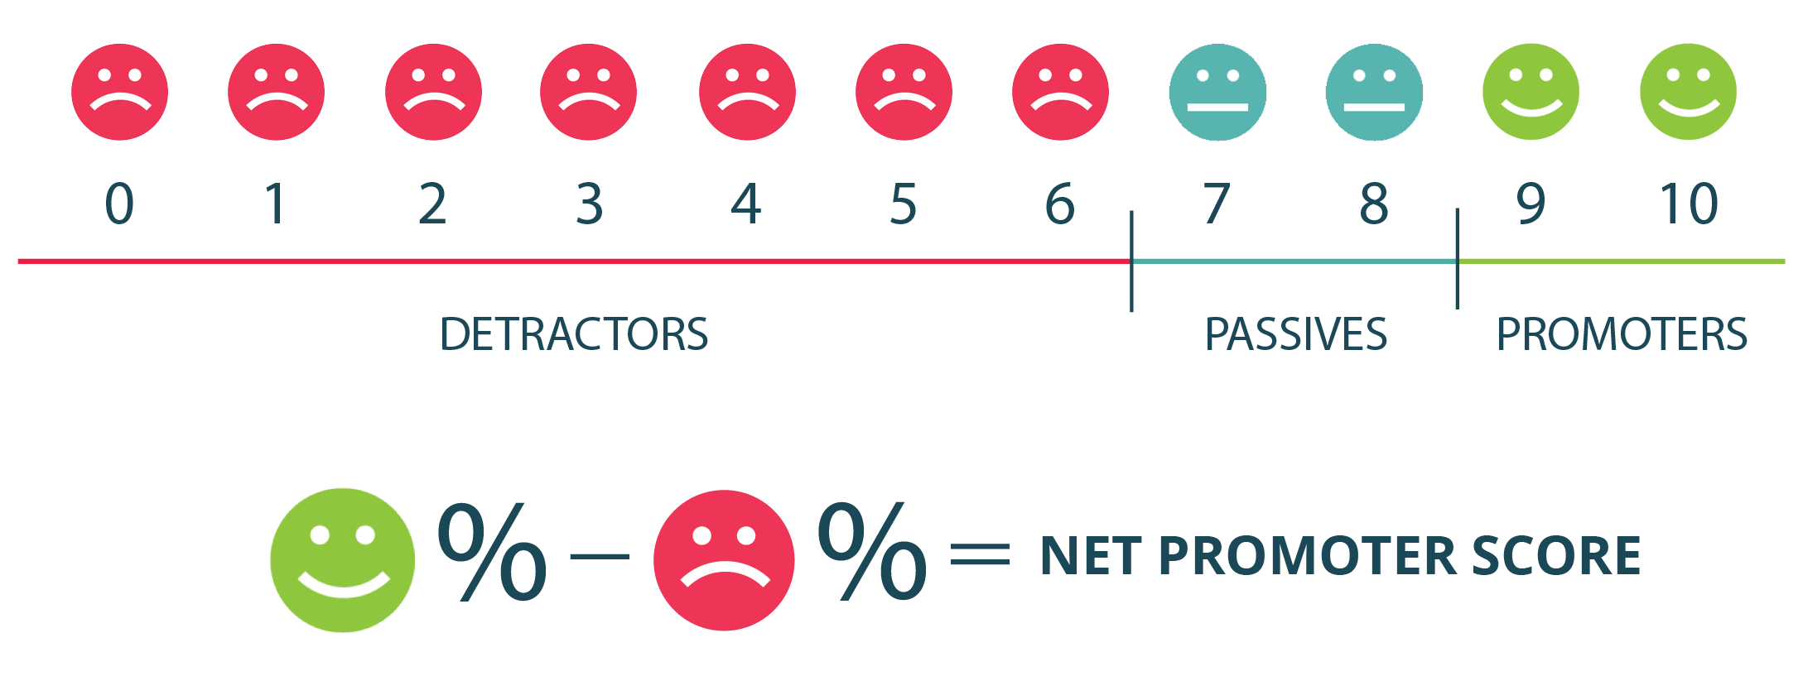
BACKGROUND
Axon is the leading provider of public safety technology solutions, which includes body cameras and digital evidence management systems. The company is deeply invested in customer experience and uses Net Promoter Score (NPS) as a key metric to measure customer satisfaction and to incentivize all Axon employees to prioritize customer needs. Axon runs an NPS based customer survey throughout the year, gathering thousands of responses annually to continually measure and shape the customer experience.
Net Promoter Score
Axon uses NPS as a key metric to measure customer satisfaction and proactively address any potential issues. They classify survey responses into 6 categories and prioritize areas of improvement based on NPS scores to enhance the customer experience.

Slide 4






PRIMARY CATEGORIES
Product
Cost
Sales
Training
Customer Service
Others
Notes:
These are the 5 pre-set primary categories that will be used to categorize the customer experience text. They are Product, cost, sales, training, customer service and others.

Slide 5
DATA GLOSSARY
Product: Related to specific products, or functions/features of products.
Cost: Cost-related experience from the customers post or pre-purchase.
Others: General comments about Axon and those without the mention of any specific category.
Sales: Pertains to the sale of the products, the product purchasing cycle, and the teams who are responsible for quote building, generating invoices, and contracts etc.
Training: Pertains to trainings that are provided for departments regarding the use of the product, and the certifications for product usage.
Customer Service: Pertains to the post purchase experience or the ongoing service experience with Axon.
Notes:
Example : comments like ‘pricing and invoicing’ represent Cost category.
Comments like ‘Great products and customer service’ represent both product and customer service, hence we add one of them in primary category (Product) and secondary category will be ‘customer service’.

Slide 6


PROBLEM STATEMENT
Axon continuously strives to enhance the customer experience by identifying problem areas through NPS and utilizing various customer surveys and operational data sources to proactively address any potential issues.
How is it currently being addressed?
The current process of feedback categorization is time-consuming, inefficient and prone to human error. Manual analysis also lacks the ability to quickly and accurately classify free-text feedback into actionable categories
What can we do to improve?
With business growing and hence increase in customer feedbacks, the current process may lead to delayed response times and missed opportunities to enhance the customer experience, which can ultimately result in lower NPS scores and negative business impact.
Therefore, it is essential to automate the existing process using a self-learning ML model which can carry out feedback analysis accurately and help gain further insights into the concern areas to improve the NPS score and overall customer experience.
Notes:
Axon considers enhanced CX as a catalyst for further growth and uses NPS as the key metric for measuring customer satisfaction. The current process of manual analysis of customer feedback to identify areas for improvement is time-consuming, inefficient and prone to human error. It also lacks the ability to quickly and accurately classify free-text feedback into actionable categories, which is critical for identifying trends and areas for improvement. With increasing sales and hence customer feedbacks, it may often lead to delayed response times and missed opportunities to enhance the customer experience, which can ultimately result in lower NPS scores and negative business impact. Therefore, it is essential to automate the existing process of manual categorization of customer feedback with a self-learning ML model which can carry out this analysis of feedback accurately and help to gain further insights into the concern areas to improve the NPS score and overall customer experience.

Slide 7
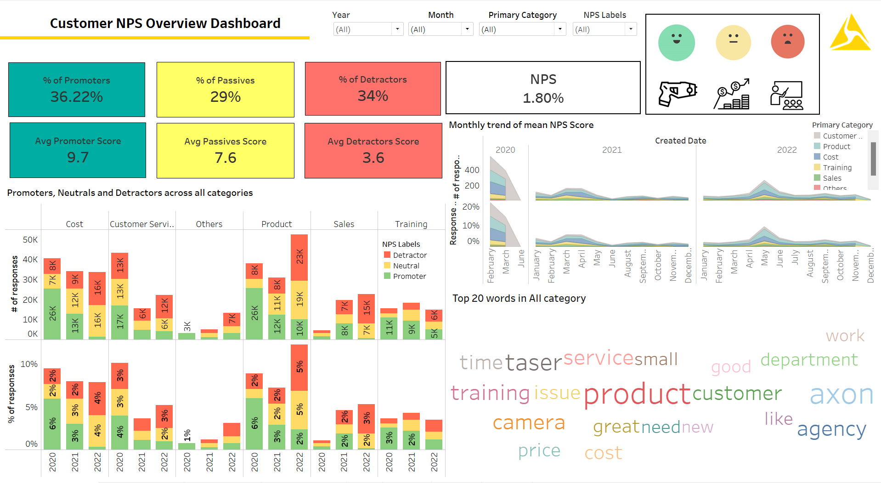
NPS RATING TRENDS
This dashboard is built on the given, already-classified data
Notes:
This dashboard is built on the data that was given to us with already classified data.
Manually classified data that was done by Sam, which was basically time consuming and mostly focused on just the detractors and hence no trends.

Slide 8
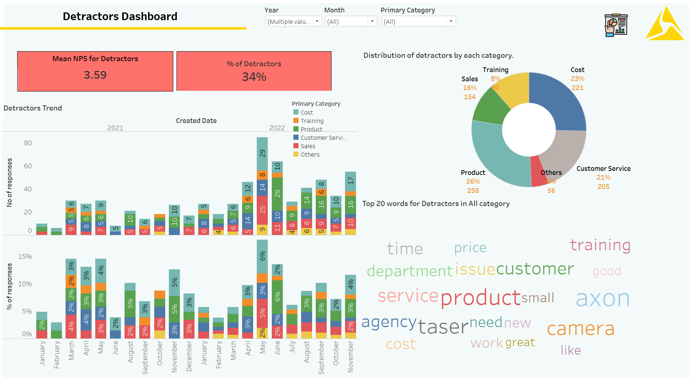
NPS RATING TRENDS
We observe that % of people belonging to Product category have the highest no. of detractors
Notes:
Categories that have high % of detractors.
% of detractors is high (34%) since we were only focusing on classifying detractors mostly.
Year 2022 , May month, had high number of detractors.
The company should focus on improving the product/ customer service to meet customer expectations and increase customer satisfaction. The company can also use customer feedback to identify areas of improvement and implement changes to improve the NPS score.

Slide 9

PROJECT PROPOSAL
The proposed project aims to utilize machine learning for efficient categorization of customer feedback into 6 categories: “Product”, “Cost”, “Customer Service”, “Training”, “Sales”, and “Others”. This will help Axon proactively identify problem and streamline the process. By reducing the manual effort required for categorization, machine learning models will provide accurate results, ultimately leading to better customer satisfaction and an improved NPS score.
Additionally, a Tableau dashboard will be created to visually represent the categorized feedback data and provide insights into the key areas of improvement. This will assist Axon in analyzing feedback more efficiently, identifying areas for improvement and providing recommendations for enhancing their customer experience.
Utilize machine learning for efficient categorization of customer feedback into 6 categories.
Help Axon proactively identify problem areas and streamline the process.
Tableau dashboard to provide insight the identify areas for improvement
Notes:
The proposed project aims to utilize machine learning for efficient categorization of customer feedback into different categories like Product, Cost, Customer Service, Training, Sales, and Others. This will help Axon in identifying problem areas more proactively and streamline the process. By reducing the manual effort required for categorization, the use of machine learning models will provide real-time accurate results, ultimately leading to better customer satisfaction and an improved NPS score.
Additionally, a Tableau dashboard will be created to visually represent the categorized feedback data and provide insights into the key areas of improvement. This will assist Axon in analyzing feedback more efficiently, identifying areas for improvement and providing recommendations for enhancing their customer experience.

Slide 10
PROCESS FLOW
Data extraction
Data cleaning
Data pre-processing
Pipeline creation for classifiers
Exploration of models
Randomized CV search for parameters
Data Wrangling
Feature Extraction
Model Building
Evaluation
1
2
3
4
SMOTE
Generate Word Embeddings
NER Tags & Text Length
Accuracy
Precision
Recall
Notes:
Lets go through the data flow.
We first performed data exploration exercise by manually classifying the unclassified data. We extracted the data and loaded the same into pandas dataframe.
Post that, we focused on cleaning and pre-processing the data.
Pre-process of data included normalization techniques such as lemmatization, stop word removal and converting all the text to lower case.
Then we moved towards feature selection and started adding AXON product list to NER.
We performed SMOTE by generating synthetic samples of minority class by interpolating them with k nearest samples.
Performed TFIDF and count vectorization.

Slide 11




DATA CLEANING
Removing uncategorized data
Concatenating various sub-categories into single primary category
Combining “Customer Success”, “Customer Experience”, and “Professional Services” under “Customer Service”
Manually aligning previous year data with the latest data and merged them together.

Slide 12
DATA PRE-PROCESSING
Duplicate Removal
Stop Words Removal
Lemmatization
Eliminate Punctuations
Conversion to Lower Case
NLP Pipeline

Slide 13
ADDITION TO THE NER
The below Axon product list as well as frequent words across all categories were input to Named Entity Recognition (NER):
PRODUCT Taser 7, Taser 10, Taser X26P, Taser X2, Fleet 3, Fleet 2, Axon Air, Axon Signal Sidearm, Axon Signal Vehicle, MY90, Evidence com, E com, Body Camera, Body Cam, T7, Body 2, Body 3, Flex 2, Axon Capture, cameras
COST expensive, budget, pricing, cheap, afford, low price, high price
TRAINING training, instructor, class, course, online, certification, cert, certificate
SALES sale, rep, contract, order, ordering, purchase, representative, quote, ship, shipping, invoice
CUSTOMER SERVICE customer, service, support, billing, customer service
Notes:
Once we are done with the pre-processing, we move towards feature extraction. Here, we are adding 4 new labels to the NER (Cost, Customer service, Training, and Sales). Each of these labels contain the most frequent words used across these categories.
Along with this we will add a list of products that axon has to the NER list as well.

Slide 14


ADDITIONAL FEATURES
1
A one-hot encoding NER vector with labels represented by zeros and ones was created, with a predefined corresponding list of NER labels.
NER Vector
2
Number of words in the text was also incorporated into the model to explore the affect it had on the predictions.
Length of Reviews
Notes:
Once we are done adding these labels, we will create a one-hot encoding NER vector of length 23 (i.e. the number of labels) it will represent which labels are in the sentence
We will also be using the length of the text as a feature in our model.

Slide 15

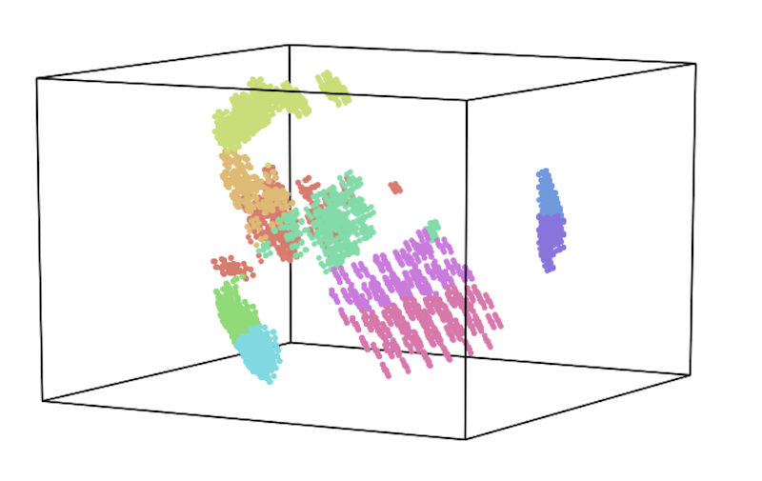
FEATURE EXTRACTION
TF-IDF & CountVectorizer
Word Embeddings
price
sales
taser
Represents text as a bag of words (i.e. use the frequency of each word to assign weights to each term)
Neural network-based model that represents words as vectors in a high-dimensional space
Considers the rarity of a word in a corpus to assign a higher weight to words that are more informative
Vectors capture semantic relationships between words, useful for text classification where meaning is important
Effective when the focus is on the identification of important keywords
Captures the context in which a word appears, allowing for the model to learn the meaning of a word from its surrounding text
Notes:
For converting our text to vectors we have looked two different approaches here .
One is the TFIDF (Represents text as a bag of words (i.e. use the frequency of each word to assign weights to each term))
And the other is the word embeddings
Where the Vectors capture semantic relationships between words, useful for text classification where meaning is important
On running the model on both, we found that the word – embeddings gave us better results ( around 3-4% increase in the F-1 score)

Slide 16
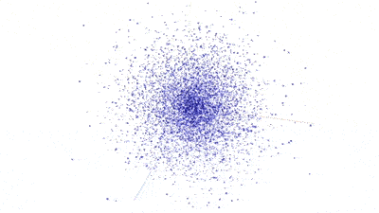
word2vec-google-news-300
The word2vec-google-news-300 is a pre-trained model using the word2vec algorithm on a large corpus of Google News articles, generating 300-dimensional word vectors for a vocabulary of around 3 million words.
As the model was trained on a large corpus of text from Google News articles—covering a broad range of topics, including business and finance—the model is likely to have seen a significant number of articles about Axon and its products and may have learned useful embeddings for these terms.
Using word2vec-google-news-300 model can be a good starting point for Axon classification problems due to its effectiveness in similar contexts.
However, the model may not capture all the nuances of Axon’s products and other information, and it may be necessary to fine-tune or supplement the model with additional domain-specific data to achieve optimal results.
Notes:
We ended up using word2vec-google-news pre-trained model. It generates 300-dimensional word vectors for a vocabulary.
Using this model was a good starting point for this problem due to its effectiveness in similar contexts.
As the model was trained on a large corpus of text from Google News articles covering a broad range of topics, including business and finance the model is likely to have seen a significant number of articles about Axon and its products and may have learned useful embeddings for these terms.

Slide 17
MODEL SUMMARY
Word Embeddings
Word embeddings are a technique used in NLP to represent words as numerical vectors. These vectors capture semantic and syntactic similarities between words, allowing for more efficient and accurate analysis of textual data. word2vec-google-news-300 is a pre-trained word embedding model consisting of 300-dimensional word vectors trained on a large corpus of Google News articles.
SMOTE
Synthetic Minority Oversampling Technique (SMOTE) works by selecting a random minority class instance and creating synthetic samples by interpolating with its k- nearest neighbors.
Classifiers
Supervised classifiers in ML are a category of algorithms that imbibe knowledge from labeled training data to make predictions on unseen instances. This genre of classifiers encompasses a diverse set of models, including Logistic Regression, Random Forest, and Support Vector Classifier (SVC).
Randomized Search
Allows for efficient exploration of the hyperparameter space and helps to find the optimal set of hyperparameters for a given model.
PIPELINE
Notes:
Model Summary
Here is the glimpse at the Model Pipepline
After generating the word embeddings and concatenating them with the additional features, we did SMOTE on our data.
SMOTE creates synthetic samples by interpolating with its k- nearest neighbors for the minority classes.
Then we used Supervised classifiers, we experimented with Logistic Regression, Random Forest, and Support Vector Classifier (SVC). While Logistic Regression with L2 Regularization gave us the best results/
Further we did randomized search, to find the optimal set of hyperparameters.

Slide 18
MODEL EVALUATION
CUSTOMER SERVICE
PRODUCT
SALES
TRAINING
COST
Notes:
We will go through the final results for each of the categories

Slide 19

MODEL EVALUATION : PRODUCT
88%
79%
86%
Accuracy
Precision
Recall
It represents the proportion of correctly classified instances over the total number of instances in the dataset.
The probability of making a correct category class classification. It's computed as the number of True Positives divided by the total number of positive calls.
The percentage of actual ‘Product’ category reviews that were correctly identified as the ‘Product’ category by the model.

Slide 20
MODEL EVALUATION
CUSTOMER SERVICE
PRODUCT
SALES
TRAINING
COST

Slide 21

MODEL EVALUATION : TRAINING
93%
68%
69%
Accuracy
Precision
Recall
It represents the proportion of correctly classified instances over the total number of instances in the dataset.
The probability of making a correct category class classification. It's computed as the number of True Positives divided by the total number of positive calls.
The percentage of actual ‘Training’ category reviews that were correctly identified as the ‘Training’ category by the model.

Slide 22
MODEL EVALUATION
CUSTOMER SERVICE
PRODUCT
SALES
TRAINING
COST

Slide 23

MODEL EVALUATION : COST
93%
86%
86%
Accuracy
Precision
Recall
It represents the proportion of correctly classified instances over the total number of instances in the dataset.
The probability of making a correct category class classification. It's computed as the number of True Positives divided by the total number of positive calls.
The percentage of actual ‘Cost’ category reviews that were correctly identified as the ‘Cost’ category by the model.

Slide 24
MODEL EVALUATION
CUSTOMER SERVICE
PRODUCT
SALES
TRAINING
COST

Slide 25
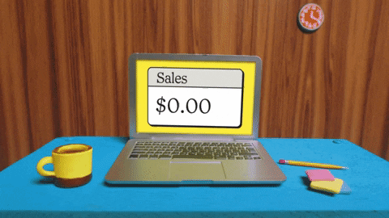
MODEL EVALUATION : SALES
88%
51%
53%
Accuracy
Precision
Recall
It represents the proportion of correctly classified instances over the total number of instances in the dataset.
The probability of making a correct category class classification. It's computed as the number of True Positives divided by the total number of positive calls.
The percentage of actual ‘Sales’ category reviews that were correctly identified as the ‘Sales’ category by the model.

Slide 26
MODEL EVALUATION
CUSTOMER SERVICE
PRODUCT
SALES
TRAINING
COST

Slide 27

MODEL EVALUATION : CUSTOMER SERVICE
79%
46%
62%
Accuracy
Precision
Recall
It represents the proportion of correctly classified instances over the total number of instances in the dataset.
The probability of making a correct category class classification. It's computed as the number of True Positives divided by the total number of positive calls.
The percentage of actual ‘Customer Service’ category reviews that were correctly identified as the ‘Customer Service’ category by the model.
Notes:
Once, we were done with building our models. We went straight to insights generation, we used our models on the uncategorized data set provided, and we were able to further classify 6000 more records.
So, we ended up building a dashboard using those records.

Slide 28
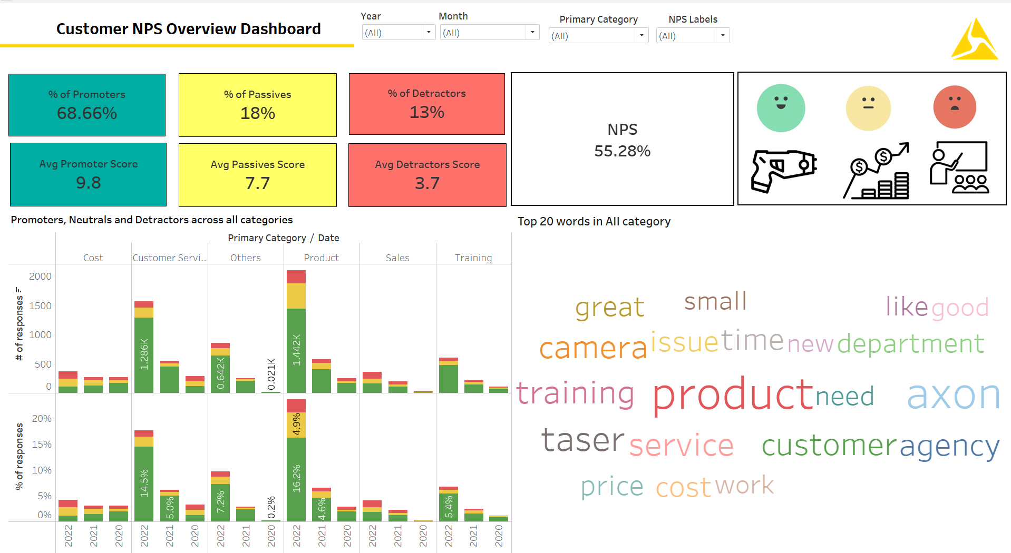
UPDATED FINDINGS
The NPS Score improved when feedback predicted as promoters and passives were incorporated instead of only focusing on the detractors.
Notes:
Gives better/more accurate picture of what is going on
Since the percentage of Promoters is high, the company can leverage this positive feedback to attract new customers and improve customer retention
Instead of just categorizing the detractors data.
A more accurate NPS score is calculated=the importance of categorizing/incorporating Promoters for an accurate diagnosis of where Axon is at=our model can do that! (rather than having sam manually categorizing…which meant only enough resource to look at the detractors)

Slide 29





MODEL VALIDATION
PRE-DEPLOYMENT
Data Collection
Collect diverse and representative data, which can be achieved by encouraging customers for feedback and simplifying the survey system.
Model Selection
Select model based on performance, complexity, scalability, interpretability, adaptability, computational efficiency, and robustness. In this case, binary classification had better results than multiclass.
Customer Feedback Validation
Validate customer feedback against model predictions to obtain insight and identify potential issues like over fitting or addition of features.
Generalization & Scalability
Test and evaluate model for its ability to generalize well to the diversity of actual customer feedback.
Evaluation Metrics
Identify appropriate metrics (e.g., F1 score, precision, recall, accuracy) to assess the model's accuracy, and scalability for reliable and accurate customer feedback prediction.

Slide 30




MODEL VALIDATION
VALIDATION
POST-DEPLOYMENT
Performance Monitoring
Monitor model performance in real-time to maintain the expected level of performance.
Data Monitoring
Analyze collected customer feedback data to identify potential issues affecting model performance and make necessary adjustments.
Continued Analysis
Compare model performance metrics pre and post deployment to evaluate effectiveness in achieving intended goals.
Feedback Analysis
Gather feedback from users to assess satisfaction and address concerns.
Notes:
Once the model has been deployed, we must look out for some post-deployment validations.
Monitor the performance and data generated by the model in real-time to ensure that it continues to perform as expected and that there are no significant drops in performance.
Comparative Analysis tells us a lot about models’ efficiency. Here we compare the system's performance metrics, before and after the model's deployment to evaluate its effectiveness in achieving the intended goals.
User Feedback in real-time would also indicate model's Realtime performance.
Regular maintenance and calibration of the system to ensure that it continues to operate accurately over time.

Slide 31
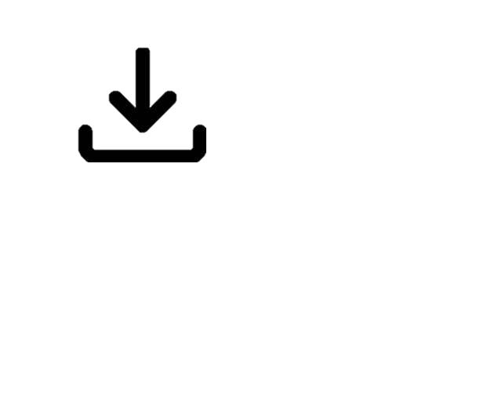


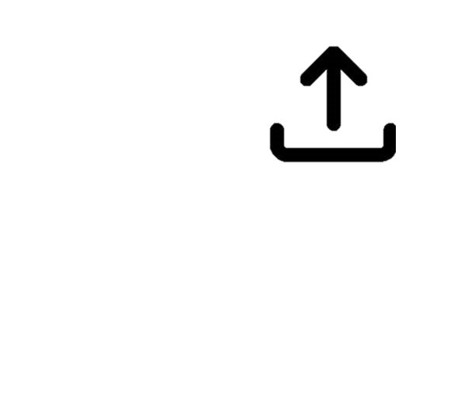
MODEL UTILIZATION
generate_model.ipynb
generate_output.ipynb
Standard csv file (with classified customer reviews), to be placed in the same directory
Model pickle file from the main directory, and the csv file with unclassified customer reviews
Input
When there is new data to train on i.e. before making substantial predictions
After the complete execution of generate_model.ipynb
When to Use
User interaction required to input probability threshold
None
User Intervention
Model pickle file, which contains the trained model fitted to across the categories
Csv file with classified customer reviews across all the categories
Output
Notes:
The final submission will contain 2 jupyter notebooks (.ipynb files)
generate_model.ipynb
Input : This file takes the standard csv file as input (with all the classified customer reviews), to be placed in the same directory.
When to run : This file needs to be run every time we have new data to train on, i.e. before making substantial predictions.
User Intervention : This file asks for probability threshold inputs across all the categories. Hence, user interaction required.
Outcomes : Output will be model.pickle file, which contains the trained model fitted to across the categories.
Note: Every time we run this file, a backup folder will be created with model_*current_timestamp* as the name, which will store the model file in it, along with a model file in the main directory.
generate_output.ipynb
Input : The file takes the model.pickle file as input from the main directory, and the csv file with unclassified customer reviews.
When to run : After the complete execution of generate_model.ipynb
User Intervention : None
Outcomes : Csv file with classified customer reviews across all the categories.

Slide 32




FUTURE SCOPE
Automation of Categorization
Dissatisfaction Prediction
Web Application Development
Regular Maintenance
The model could be hosted on a server so that when customer feedback is received, it can automatically categorize them based on the categories saved in the database
The model could be enhanced to predict dissatisfaction from survey responses for proactive measures to prevent a low NPS score
A web application could be developed to easily access trends by categories, trends by NPS scores, and other relevant information
The model should be regularly trained on new customer feedbacks to ensure its robustness and efficient performance
Notes:
Automating the categorization of customer feedback- The model can be hosted on the server so that as and when a customer feedback is received, it is categorized as per the primary categories taken into consideration and saved in the database.
Web Application- Real time monitoring of the customer satisfaction basis the primary categories can be done with a web application that can display the customer details, dissatisfaction reason and other details on a click.
Prediction of dissatisfaction- The model can be further enhanced to predict the dissatisfaction from the customer feedback received to proactively take measures to prevent a lower NPS score.
Regular updating of model- The model needs to be trained on new customer feedbacks in regular intervals so that it remains robust and performs efficiently.

Slide 33
THANK YOU
Amit Manocha
Helen Kim
Siri Kademani
Supratim Roy Chowdhury

Slide 34
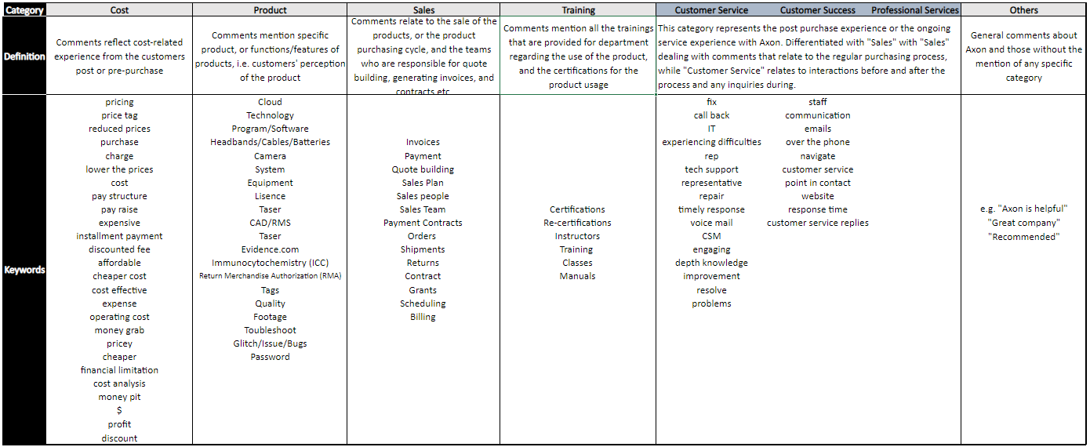
APPENDIX: DATA GLOSSARY

